Slide 1
EARLY PREDICTION OF LIFESTYLE DISEASES
PIP104 PROFESSIONAL PRACTICE-II
VIVA-VOCE
Batch Number:
Roll Number: 20201CSD0139 20201CSD0147 20201CSD0148 | Student Name Shreya S Shilpi Prasad Amrutha B V
Under the Supervision of,
Mrs. Ramyavathsala C V
Assistant Professor
School of Computer Science Engineering & Information Science
Presidency University

Slide 2
Introduction
The modern period is marked by an increase in lifestyle diseases, which include conditions like diabetes and cardiovascular disorders. Dietary changes, increased stress levels, and sedentary lifestyle choices all play a major role in the rising incidence of these illnesses. This phenomenon has its roots in the development of contemporary living, when convenience-driven lives and technology improvements have proliferated.
The World Health Organization (WHO) and other international health organizations have acknowledged lifestyle diseases as a significant public health concern because of this change. The course of these illnesses emphasizes the necessity of preventative actions, with a focus on early identification, prompt treatment, and public education. This study aligns with the larger goal of changing public health practices by utilizing machine learning as a tool for early prediction.

Slide 3
Literature Review
Proposed Model for Lifestyle Disease Prediction Using SVM -IEEE-4348 (2018)
Personalized Health Monitoring using Predictive Analytics - IEEE (2019)
Machine-Learning-Based Prediction Models of Coronary Heart Disease Using Naïve Bayes and Random Forest Algorithms - ICSECS-ICOCSIM (2021)
Heart Disease Prediction Using Machine Learning Techniques (2021)
Prediction of cardiovascular disease using machine learning algorithm (2018)
A study on early prediction of Lung Cancer using machine learning techniques (2020)
Early risk prediction of cervical cancer: A machine learning approach (2022)
Evaluation-based Approaches for Liver Disease Prediction using Machine Learning Algorithm (ICCI-2021)

Slide 4
Research Gaps Identified
Prediction of Cardiovascular Disease using Machine Learning Algorithms (2018)
Absence of healthcare data biases and comprehensive dataset analysis.
Superficial comparison of machine learning techniques.
Lack of in-depth exploration of method advantages.
Insufficient focus on robust validation techniques.
Missing discussion on real-world model application, ethical considerations, and practical implementation hurdles.

Slide 5
A study on Early Prediction of Lung Cancer using Machine Learning Techniques(2020)-
Research on early lung cancer prediction focuses on traditional machine learning but lacks robustness.
Limitations include inadequate dataset diversity, handling of unbalanced data, weak feature selection comparisons, and insufficient validation procedures.
The study overlooks sophisticated methods like deep learning or ensembles, restricting its clinical applicability.
Enhancing data quality, addressing imbalanced data, robust feature selection, and adopting modern ML techniques can significantly improve prediction accuracy and practical utility.

Slide 6
Heart Disease Prediction using Hybrid machine learning model. (2021)
Utilizes ML techniques like Random Forest and Decision Tree for heart disease prediction.
Focuses on a hybrid model combining these techniques but lacks exploration of newer models.
Addresses binary classification of heart disease (0 for absence, 1 for presence) using standard datasets like Cleveland.
Criticizes prior research for over-reliance on conventional ML methods, emphasizing the need for more sophisticated approaches.
Highlights the necessity for comprehensive investigations and improved models to enhance cardiac disease forecasting's accuracy and practicality.

Slide 7
Early risk prediction of cervical cancer: A machine learning approach (2022)
Focuses on early risk prediction of cervical cancer using 11 supervised ML algorithms.
Initially achieves 93.33% accuracy, with the MLP model showing superiority.
Through Grid Search Cross-Validation (GSCV), enhances accuracy to 93.33% with DTC, RFC, KNN, SVM, and MLP.
Identifies limitations: dataset size, imbalanced data management, interpretability, ethical considerations, generalizability, and clinical validation.
Highlights the potential of ML in healthcare while stressing the importance of rigorous validation, ethical review, and real-world testing before clinical implementation.

Slide 8
Evaluation based approach for Liver Disease Prediction using Machine Learning Algorithms(2021)
Acknowledges research gaps: larger and diverse datasets, comprehensive model performance measures, and practical application challenges in clinical settings.
Suggests addressing these gaps to enhance ML-based liver disease prediction contributions.

Slide 9
Heart disease prediction using machine learning techniques (2021)
Focuses on ML for early heart disease prediction.
Urges simpler risk assessment due to lifestyle factors.
Gaps: imbalanced data handling, limited metrics, lacks real-time insights.
Insufficient feature relevance and ethical considerations.
Proposes accuracy and usability improvements but misses scalability focus.
Closing gaps could enhance model validity.

Slide 10
Proposed Methodology
Data Preparation- Source databases with associated disease classifications and symptoms are used for data collection.
Investigative Data Analysis (EDA): Examine and illustrate the properties of the dataset.
Preprocessing: Choose pertinent features, encode labels, and deal with missing data.
Model Selection: For classification, use Random Forest, Gaussian Naive Bayes, and Support Vector Classifier (SVC).
Training: Build models using the training set after splitting the data.
Combined Model Evaluation: Combine forecasts from every model by means of a voting system.
Web Application: Combining models with a Flask web application to create an intuitive user experience.
User testing: Get input from users to make changes.
Deployment: For accessibility, host the Flask application on a web server.
Code Documentation: Give the codebase comprehensive documentation.
Project Report: Compile a comprehensive report covering dataset insights, model development, and application details.
Artifact Saving: Use Pickle to store label encoders, dictionaries, and trained models for later use.

Slide 11
Objectives
Machine Learning Model Development
Web Application Creation
Intended Illnesses
Worldwide Usability

Slide 12
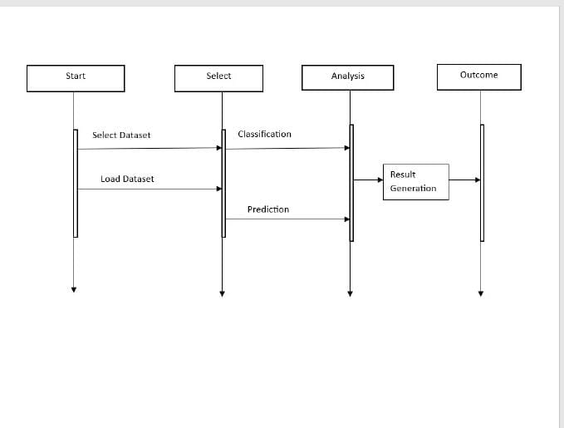
System Design & Implementation
The user engages the application, selecting a dataset triggering its loading. The loaded dataset undergoes thorough analysis, including cleaning, feature extraction, and normalization for machine learning. Once analyzed, the system uses classification algorithms to predict disease likelihood based on input features. Machine learning models assign probabilities to disease outcomes. Finally, the system compiles and presents user-friendly disease predictions, streamlining the complex prediction process.

Slide 13
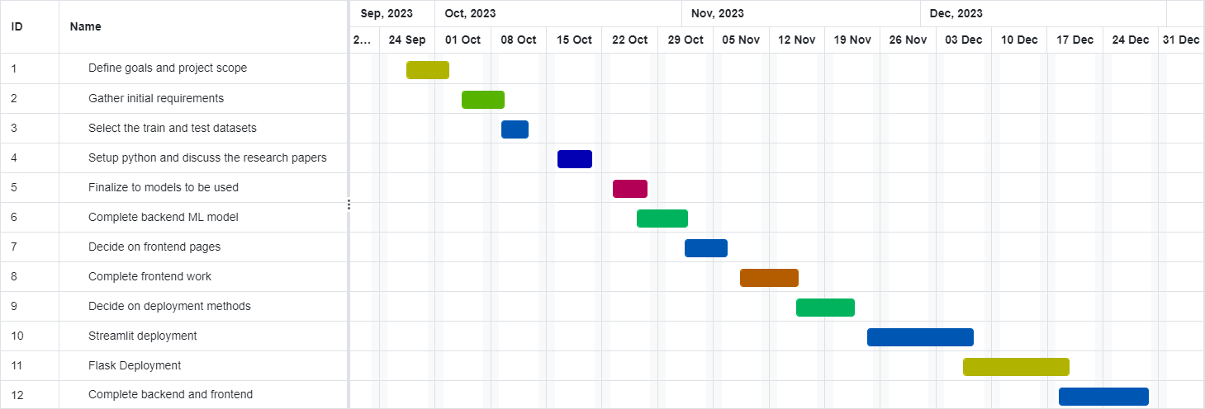
Timeline of Project

Slide 14
Outcomes / Results Obtained
Compare SVM, Naive Bayes, Random Forest for disease prediction.
Analyze confusion matrices to understand model performance.
Evaluate composite model accuracy (RF, NB, SVM combined).
Identify impactful symptoms on illness prognosis.
Assess web app's disease prediction and user experience.
Discuss economic ML models for lifestyle illness prediction.

Slide 15
Conclusion
The project developed and evaluated machine learning models (SVM, Naive Bayes, Random Forest) for lifestyle disease prediction based on symptoms. Findings emphasized the importance of symptoms, model accuracy, and the effectiveness of ensemble methods. A user-friendly web application demonstrated potential for disease prediction using symptoms input. Additionally, a cost-effective ML model proposed an alternative to DNA testing, focusing on preventing diseases via lifestyle factors. This work represents progress in proactive healthcare, offering possibilities for early disease identification and personalized health interventions.

Slide 16
References
[1]Mrunmayi Patil ,Vivian Brian Lobo, Pranav Puranik, Aditi Pawaskar, Adarsh Pai, Rupesh Mishra, U.G. student , Assistant Professor, Department of Computer Engineering, St. Francis Institute of Technology, Mumbai, India.: Proposed Model for Lifestyle Disease Prediction Using Support Vector Machine.IEEE-4348(2018)
[2]Weneen Wu*,Sneha Vadakkemadathil, Poojitha Amin, Nikitha R. Anikireddypally, Suraj Kuhrana.:Personalized Health Monitoring using Predictive Analytics. 2019 IEEE Fifth International Conference on Big Data Computing Service and Applications (BigDataService)
[3]Charels Bernando, Eka Miranda , Mediana Aryuni, Bina Nusantara University, Indonesia,: Machine-Learning-Based Prediction Models of Coronary Heart Disease Using Naïve Bayes and Random Forest Algorithms. 2021 International Conference on Software Engineering & Computer Systems and 4th International Conference on Computational Science and Information Management(ICSECS-ICOCSIM)
[4]Sunitha Guruprasad, Valesh Levin Mathias , Winslet Dccunha, St.Joseph Engineering College.: Heart Disease Prediction Using Machine Learning Techniques.2021
[5]C.Geetha/Assistant Professor , Dr.AR.Arunachalam/HOD-Dean, Dr. MGR University, Bharath Institute of Higher Education and Research,Chennai.: Evaluation based Approches for Liver Disease Prediction using Machine Learning Algorithm.(ICCI-2021)
[6]Ishrak Jahan Ratul, Abdullah Al-Monsur, Bushra Tabassum, Abrar Mohammad Ar-Rafi, Mirza Muntasir Nishat and Fahim Faisal Department of Electrical and Electronic Engineering Islamic University of Technology Dhaka, Bangladesh.: Early risk prediction of cervical cancer: A machine learning approach(2022)
[7]Dr. M. Kavitha1* , G. Gnaneswar1 , R. Dinesh1 , Y. Rohith Sai1 , R. Sai Suraj1 1* Assistant Professor, 1 Student Department of Computer Science and Engineering, Koneru Lakshmaiah Education Foundation, Vaddeswaram, AP, India.: Heart Disease Prediction using Hybrid machine learning model.
[8]Proceedings of the Third International Conference on Intelligent Sustainable Systems [ICISS 2020] IEEE Xplore Part Number: CFP20M19-ART; ISBN: 978-1-7281-7089-3 .: A Study on Early Prediction of Lung Cancer Using Machine Learning Techniques
[9]Proceeding of 2018 IEEE International Conference on Current Trends toward Converging Technologies, Coimbatore, India 978-1-5386-3702-9/18. Dinesh Kumar G , Santhosh Kumar D, Arumugaraj K , areeswari V, VIT University.: 2018 IEEE 1 Prediction of Cardiovascular Disease Using Machine Learning Algorithms

Slide 17
Publication Details
Published the paper ”Early Prediction of Lifestyle Diseases” in “International Journal of Innovative Research in Computer and Communication Engineering(IJIRCCE) volume 12,Issue 1, January 2024”

Slide 18
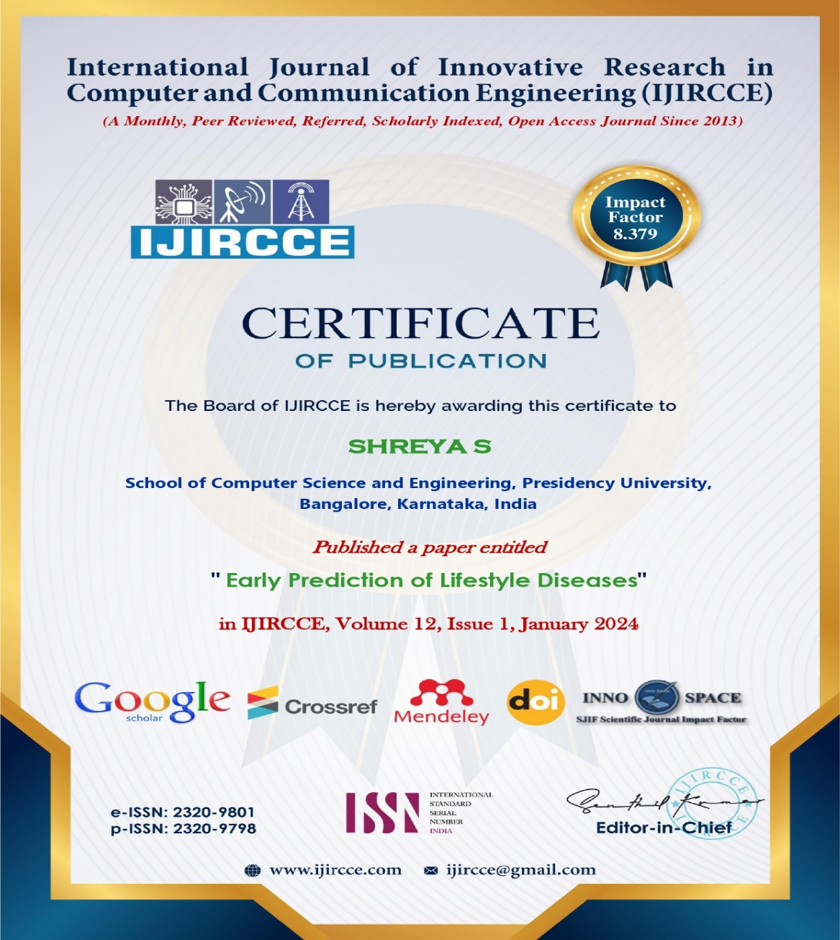

Slide 19


Slide 20


Slide 21
Achievements (if any)

Slide 22

Thank You

